Slide 1


Slide 2

Nguyễn Bùi Thanh Trúc – IELSIU19083
Nguyễn Mộng Mỹ Linh – IELSIU19090
Phạm Tuyết Ngân – IELSIU19048
Nguyễn Vũ Quỳnh Như – IELSIU18243
Lê Quang Dũng – IEIEIU18015

Slide 3
Introduction
Content
Methodology
Operation Process

Slide 5
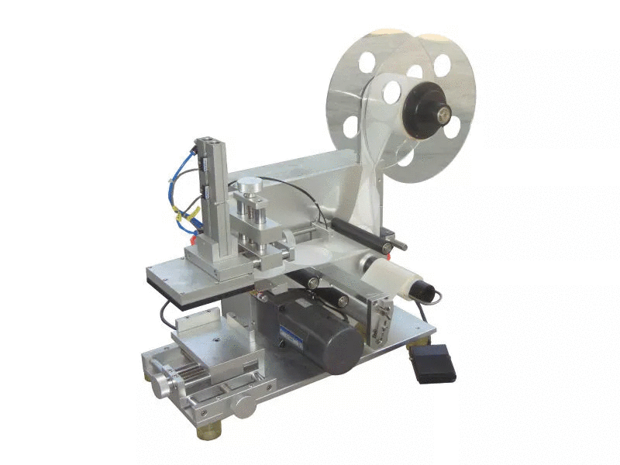
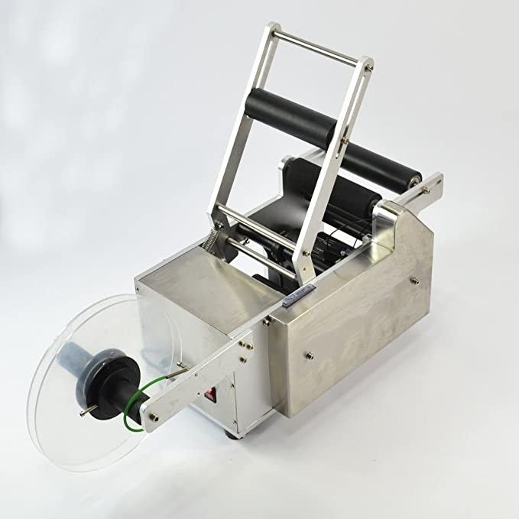
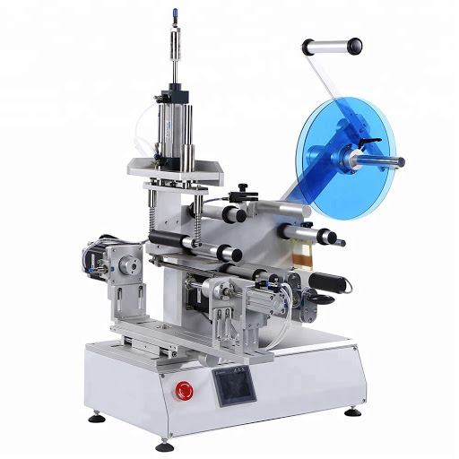
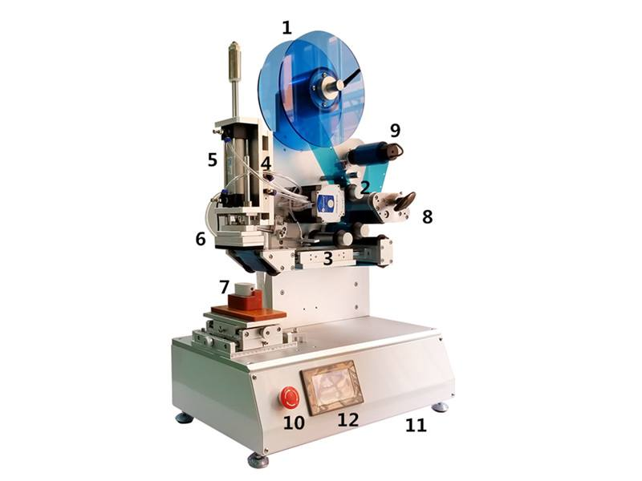
During the process of producing bottles, the labelling stage plays a vital role which gives bottles their own signature. The type of labelling machine should be designed carefully according to the bottle structure such as shape, size and even material of the bottles.
XT-50 semi automatic labeling machine
Semi-auto labeling machine for flat square bottle
MT-50 semi-automatic labelling machine
FA-603 semi-auto high precision flat labeling machine

Slide 6
Convenient for small companies
Mass production
Save money and time
Mobility of labour

Slide 7
Constant laborer’s
work
Machine dependence
High operation cost

Slide 9
Searching for Idea
Agreed with idea
Sketching with Tinkercad
Buying materials
Building machine
Writing the Arduino software and code for programming
Setting for use

Slide 10
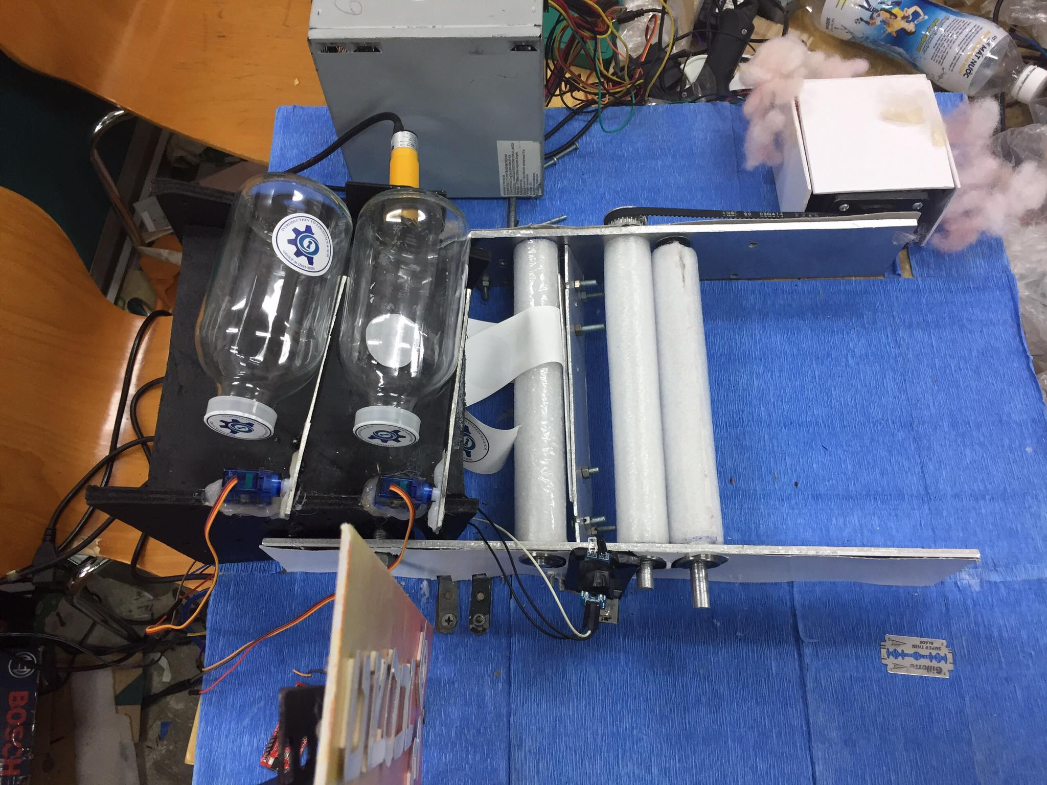

Slide 11
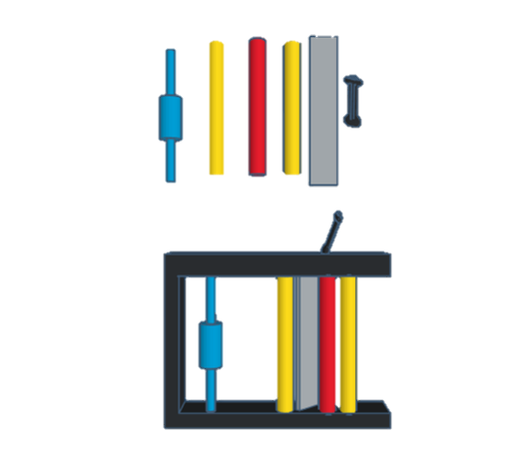
Sticker Seperator
Sticker roll
Main sticker-pulling rolls

Slide 12
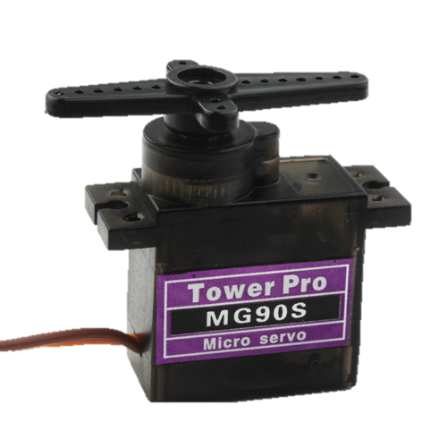
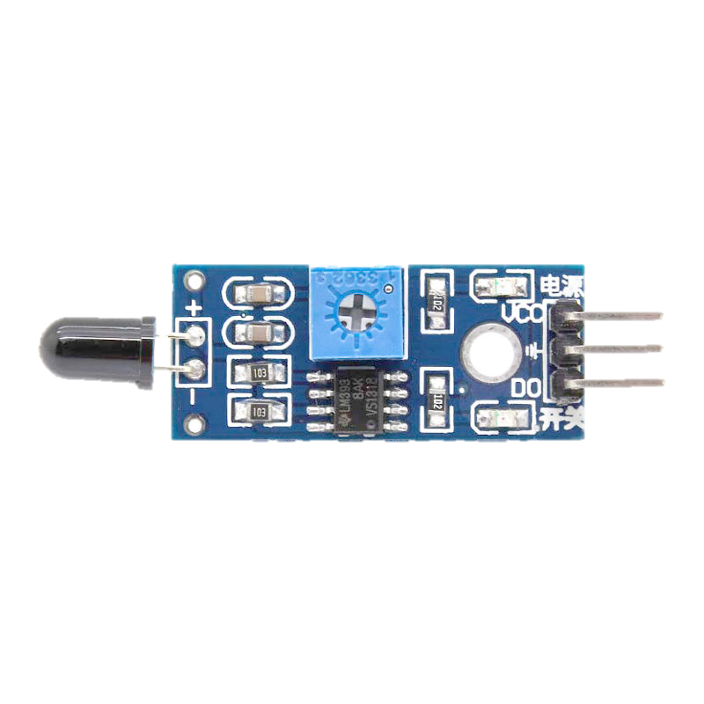
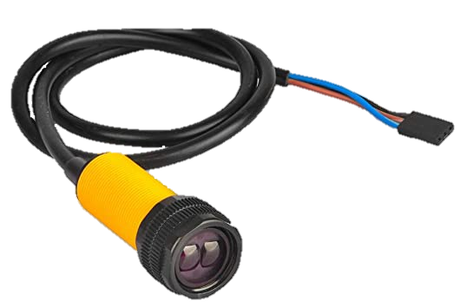
- Tilted surface
- Mini servo motor (MG90S)
- Sensor (E18-D80NK)
- Sensor (Flying fish MH-B)

Slide 13
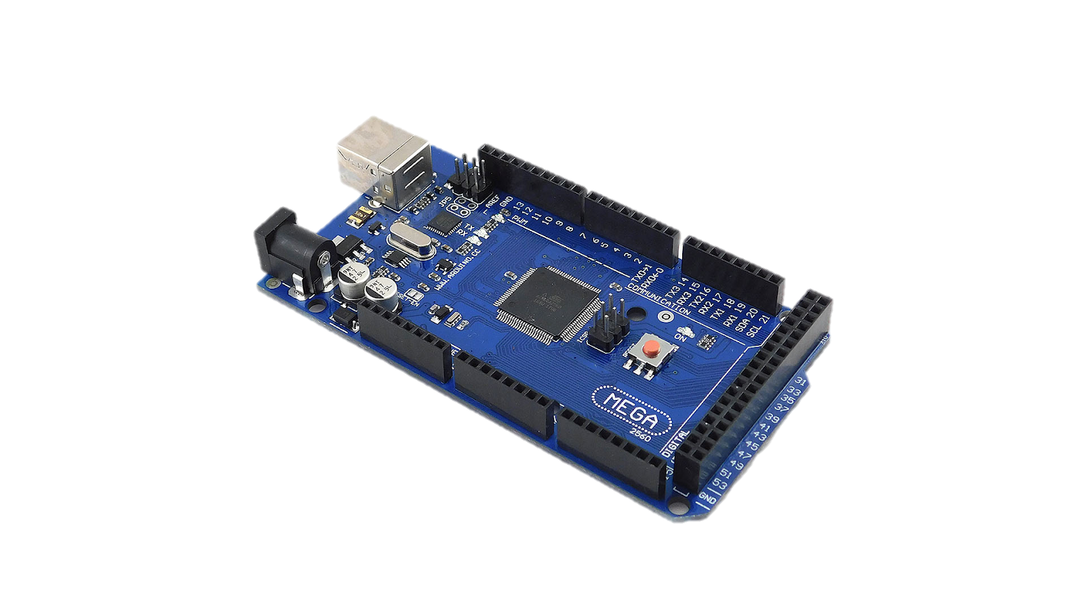
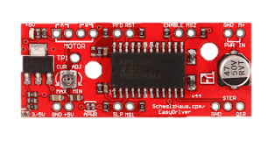
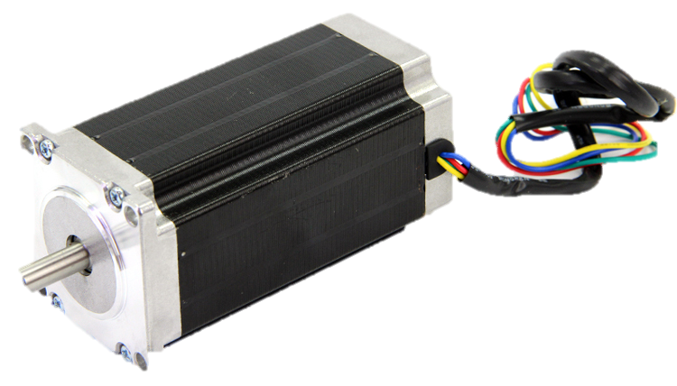
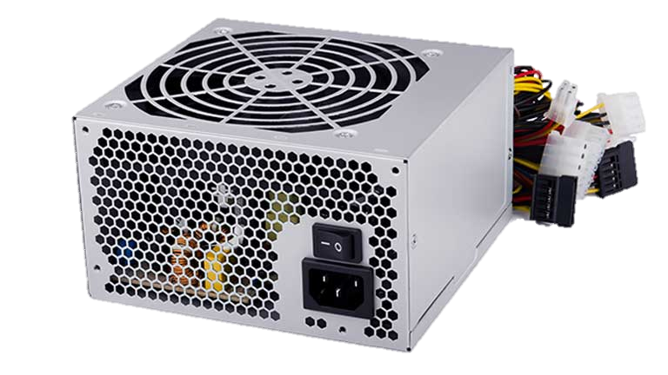
Driver
A3967
Arduino
Stepper motor
Power
Supply

Slide 15
Input: Bottle by hand
Bottle roll to labeling placement
Machine begin to run
Bottle is labelled
Output: bottle by hand
Repeat
Bottle A
Sensor 2
Bottle B
Servo 1
Sensor 1
Servo 2

Slide 16
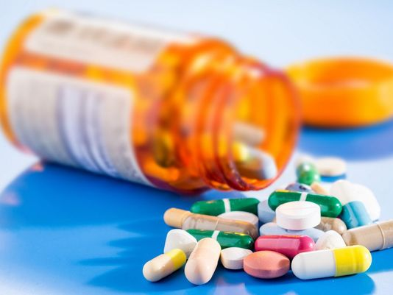

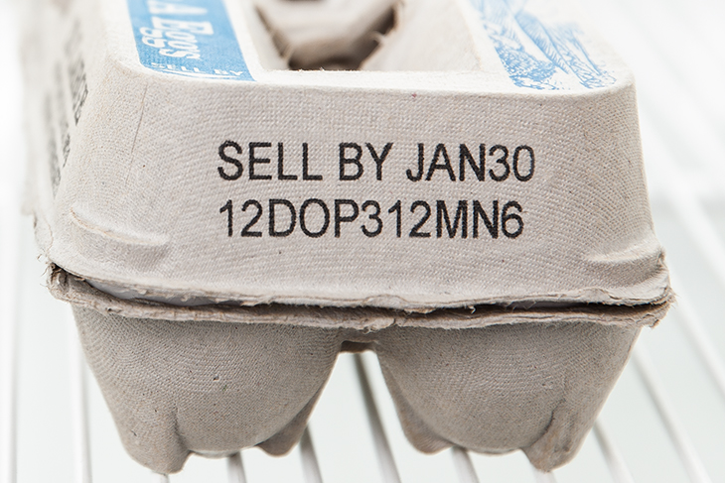
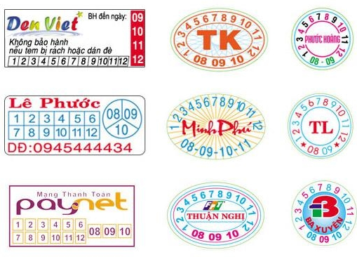
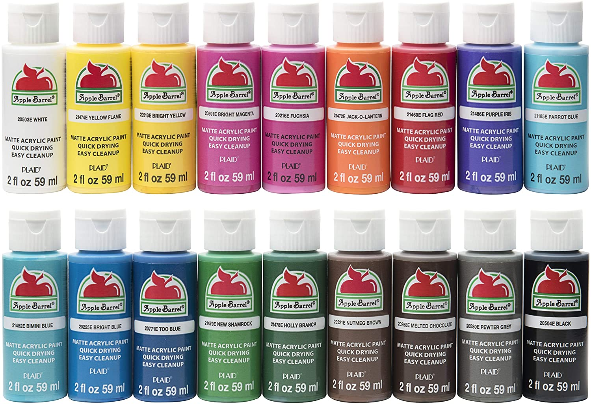
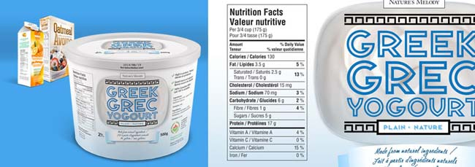
Applied in various career fields in life
Used in printing special stamps

Slide 17
Do you have any questions?

